Slide 2
Speech LLMs
Part 1: Audio-Conditioned LLMs
Максименко Александр
Senior DLE, GigaChat Audio

Slide 3
Plan
Why LLM
Why AudioLLM
What is Audio LLM
Types of AudioLLM
Audio-conditioned LLM tasks
Audio Input: encoders & speech tokens
Integration Audio embeddings into LLM
Training stages and data
Case Study

Slide 4





Why LLM
Human-like Interaction
Accessibility
Versatility
APIs and open-source models allow developers and businesses to easily integrate powerful AI, fueling rapid adoption.
One model can translate, summarize, write code, and answer questions—a "Swiss Army knife" for knowledge tasks.
Models like ChatGPT showed millions that AI could understand nuance, write coherently, and generate human-like text.

Slide 5





Why LLM
Scalable Architecture
Massive Data
Emergent Abilities
The "Transformer" architecture is highly parallel and scales predictably. More data & compute = better performance.
Trained on internet-scale text, models learn vast knowledge, language patterns, and reasoning abilities.
At scale, models develop new skills they weren't explicitly trained for, such as "zero-shot" learning and reasoning.

Slide 6
Why LLM
Traditional Approach: Specialized Models
Data Domain 1
Model 1
Task 1
Data Domain 3
Model 3
Task 3
Data Domain 2
Model 2
Task 2
Data Domain 4
Model 4
Task 4

Slide 7
Why LLM
LLM-based Approach: One for All
Large Scale Dataset
Foundation Model
Task 1
Task 2
Task 3
Task 4

Slide 8
Why AudioLLM
AudioLLM-based Approach: One for All
Large Scale Audio Dataset
Foundation Model
Task 1
Task 2
Task 3
Task 4

Slide 9


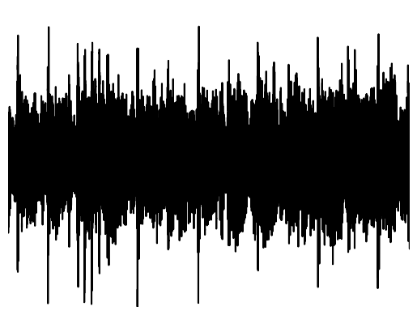
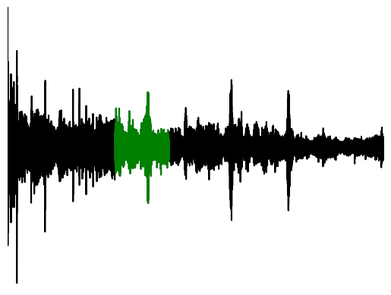
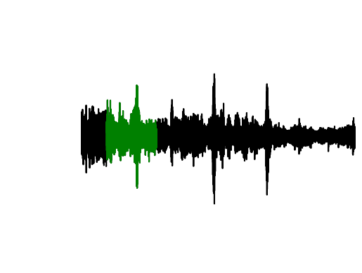
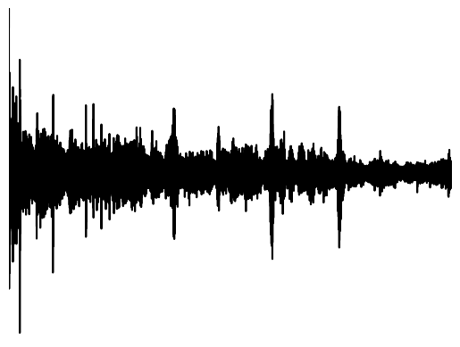



Voice Assistant Pipeline
Partial
Recognition
Hotword
Validation
Intended Query Detection
Prefetching
сбер
Endpoint
Detection
Speech
Recognition
Punctuation
Speaker Identification
Whisper Detection
Speech Enhancement
Hotword
Detection
Speech Separation
Emotion
Recognition
Noise Detection
сбер измени пожалуйста условия по моему кредиту
Quick Commands
128 Mb
Intent Recognition
Speech
Synthesis
Что нужно изменить?
Text
Normalization
Language Generation
Dialog Management

Slide 10
Voice Assistant Pipeline
Partial
Recognition
Hotword
Validation
Intended Query Detection
Prefetching
сбер
Endpoint
Detection
Speech
Recognition
Punctuation
Speaker Identification
Whisper Detection
Speech Enhancement
Hotword
Detection
Speech Separation
Emotion
Recognition
Noise Detection
сбер измени пожалуйста условия по моему кредиту
Quick Commands
128 Mb
LLM
Speech
Synthesis
Что нужно изменить?
Text
Normalization

Slide 11
Voice Assistant Pipeline: Endgame
Audio Encoder
сбер
Speech Enhancement
Hotword
Detection
Noise Detection
Quick Commands
<Audio Representations>
128 Mb
LLM
Audio Decoder
<Audio Representations>

Slide 12
AudioLLM For ASR
Hard to compare Approaches
Hard enough to compare Models
Insufficiency of WER

Slide 13
AudioLLM For ASR
Task | Llama 3 8B | Llama 3 70B | Whisper | SeamlessM4T | Gemini 1.0 Ultra | Gemini 1.5 Pro
MLS (English) | 4.9 | 4.4 | 6.2 (v2) | 6.5 | 4.4 | 4.2
LibriSpeech (test-other) | 3.4 | 3.1 | 4.9 (v2) | 6.2 | - | -
VoxPopuli (English) | 6.2 | 5.7 | 7.0 (v2) | 7.0 | - | -
FLEURS (34 languages) | 9.6 | 8.2 | 14.4 (v3) | 11.7 | - | -
https://arxiv.org/pdf/2407.21783

Slide 14
AudioLLM For ASR
Category | Task | Metric | USM | Whisper | 1.0 Pro | 1.0 Ultra | 1.5 Flash | 1.5 Pro
ASR | YouTube (en-us) | WER | 5.8% | 6.5% | 4.8% | 4.7% | 4.9% | 4.8%
ASR | YouTube (52 lang) | WER | 22.8% | 41.4% | 22.5% | 21.0% | 23.8% | 22.6%
ASR | Multilingual LibriSpeech (en-us) | WER | 7.0% | 6.2% | 4.8% | 4.4% | 5.2% | 4.2%
ASR | FLEURS (55 lang) | WER | 11.2% | 16.6% | 6.4% | 6.0% | 9.8% | 6.5%
AST | Covost 2 (20 lang) | BLEU (↑) | 31.5 | 29.4 | 40.0 | 41.0 | 36.1 | 39.4
https://arxiv.org/pdf/2312.11805

Slide 15
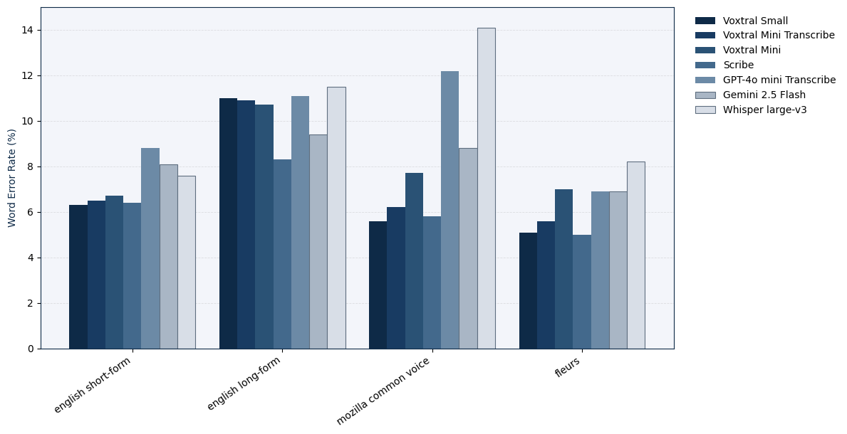
AudioLLM For ASR
https://arxiv.org/pdf/2507.13264v1

Slide 16
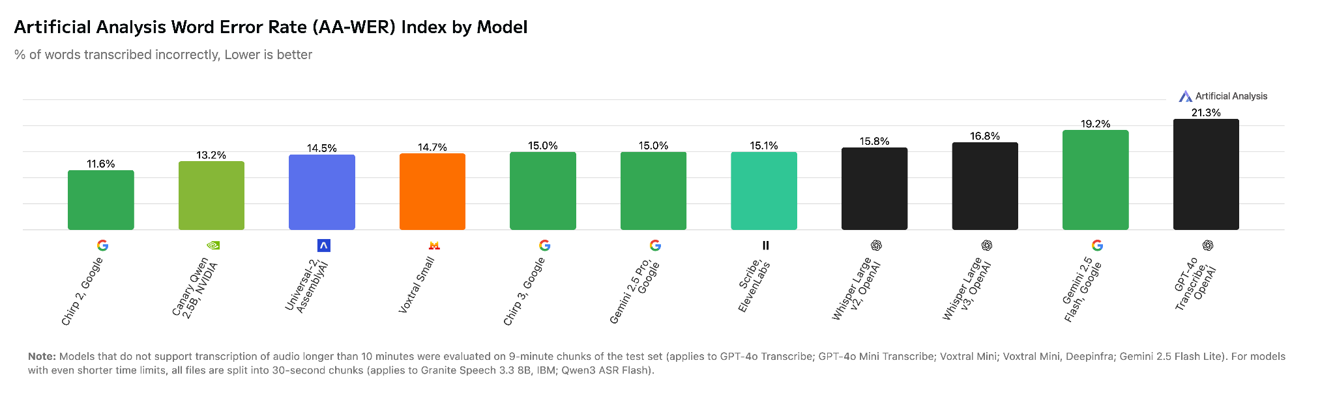
AudioLLM For ASR
https://artificialanalysis.ai/speech-to-text?error-rate=word-error-rate#artificial-analysis-word-error-rate-aa-wer-index-by-model

Slide 17







What is LLM
Input Modality
Output Modality
Text
Text-Only LLM
Text

Slide 18


What is AudioLLM
Input Modality
Output Modality
Text
Text
Multimodal LLM
Input Modality
Output Modality
Audio
Audio

Slide 19

What is AudioLLM
Input Modality
Output Modality
Text
Text
Multimodal LLM
Input Modality
Output Modality
Audio
Audio

Slide 20
What is AudioLLM
Input Modality
Output Modality
Text
Text
Multimodal LLM
Input Modality
Output Modality
Audio
Text to Audio (T2A)
Text to Speech (T2S)
Audio

Slide 21
What is AudioLLM
Input Modality
Output Modality
Text
Text
Multimodal LLM
Input Modality
Output Modality
Audio
Audio

Slide 22
What is AudioLLM
Input Modality
Output Modality
Text
Text
Multimodal LLM
Input Modality
Output Modality
Audio
Audio to Audio (A2A)
Speech to Speech (S2S)
Audio

Slide 23

What is AudioLLM
Input Modality
Output Modality
Text
Text
Multimodal LLM
Input Modality
Output Modality
Audio
Audio

Slide 24
What is AudioLLM
Input Modality
Output Modality
Text
Text
Multimodal LLM
Input Modality
Output Modality
Audio
Audio to Text (A2T)
Speech to Text (S2T)
Audio

Slide 25
What is AudioLLM
Input Modality
Output Modality
Text
Text
Multimodal LLM
Input Modality
Audio
Audio to Text (A2T)
Speech to Text (S2T)

Slide 26
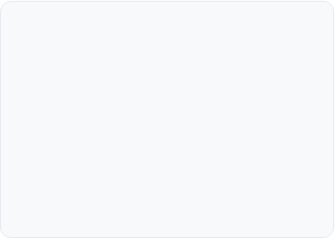
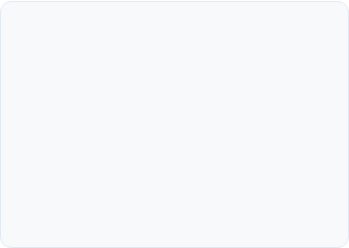
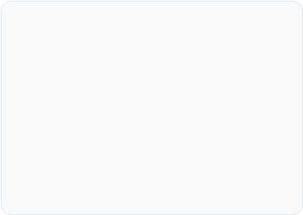



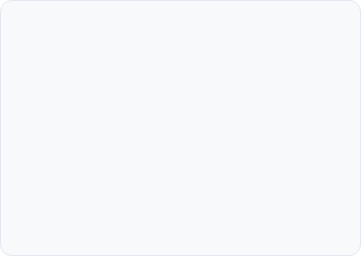
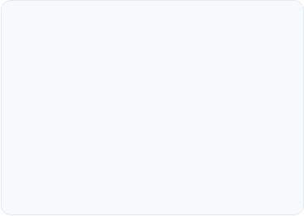
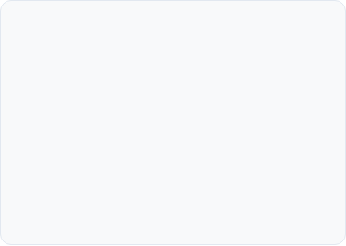


Audio-Conditioned LLM abilities
ASR
AST
AQA
Automatic Speech Recognition (Speech-to-Text)
Automatic Speech Translation (Speech-to-Translation)
Audio Question Answering (Answering questions about audio, Close-Ended)
…
Speaker Tasks
AED
Any other task
Speaker Diarization & Identification (Who spoke and when?)
Audio Event Detection (Identifying non-speech sounds)
Captioning, Spoken Language Understanding, Speaker Emotion Recognition, …

Slide 27
Audio-Conditioned LLM abilities
ASR
AST
AQA
WORD ERROR RATE (WER)
BLEU, ROGUE, METEOR
MMLU-Like setup: Accuracy
…
Speaker Tasks
AED
Any other task
Diarization Metrics, SID Metrics, …
Classification metrics, mAP
?

Slide 28
Audio-Conditioned LLM abilities
Summarization
Contextuality
Empathy
?
?
?
…
Usefullness
Beauty
?
?

Slide 29

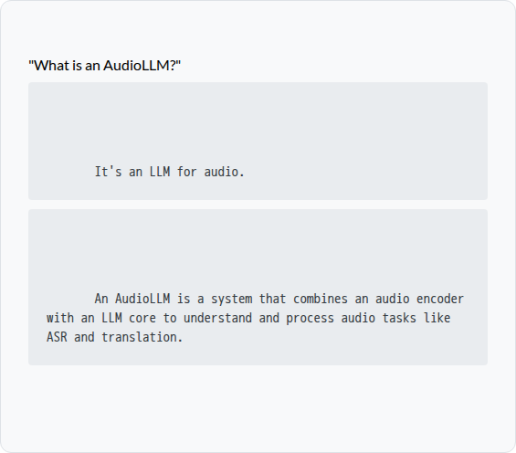



Human Preferences: Pairwise Comparison
Rater Instructions
User Prompt:
You will be shown a user prompt and two anonymous answers, Answer A and Answer B.
[Answer A]
Your Task: Read both answers carefully and decide which answer is better. If they are very similar or equally good/bad, you may choose 'Tie'.
[Answer B]
Criteria: Judge based on helpfulness, accuracy, and clarity. A better answer directly addresses the user's prompt, is factually correct, and is well-written.
Example: An answer that is comprehensive is better than one that is too brief.

Slide 30

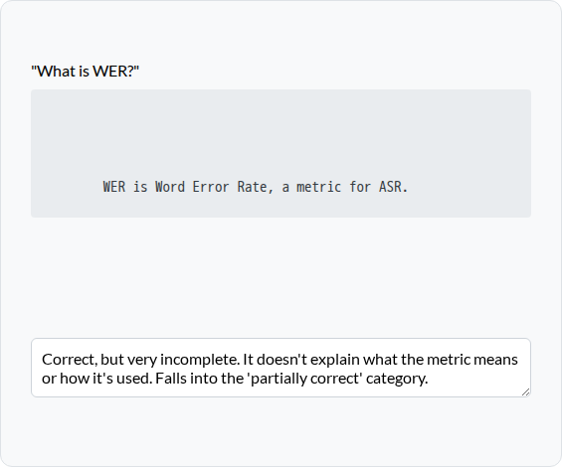
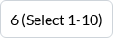
Human Preferences: Single Answer Grading
Rater Instructions
User Prompt:
You will be shown a user prompt and a single model's answer.
[Answer]
Your Task: Rate the quality of the answer on a scale from 1 (Bad) to 10 (Excellent) based on the provided rubric.
Rubric:
Overall Score:
• 1-3: Incorrect, harmful, or irrelevant.
• 4-6: Partially correct but incomplete or poorly written.
Justification:
• 7-8: Helpful and accurate, but could be more detailed.
• 9-10: Excellent, comprehensive, and well-written.
Please provide a brief justification for your score.

Slide 31
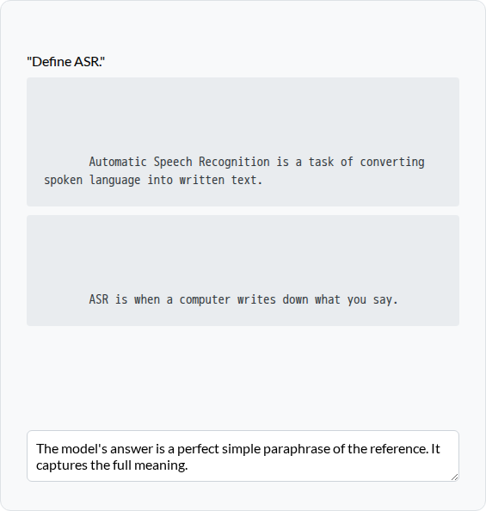
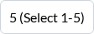
Human Preferences: Reference-Guided Grading
User Prompt:
Rater Instructions
[Reference Answer]
You will be shown a prompt, a model's "Answer", and a "gold" "Reference Answer".
Your Task: Compare the model's "Answer" to the "Reference". Rate how well the model's answer captures the *meaning* of the reference, on a scale of 1-5.
[Model Answer]
Rubric (Meaning):
Meaning Score:
• 1: Contradicts the reference.
• 3: Captures some, but not all, of the meaning.
Justification:
• 5: Captures all of the meaning. Paraphrasing is acceptable.

Slide 32
Human Preferences
Pros:
Cons:

Slide 33

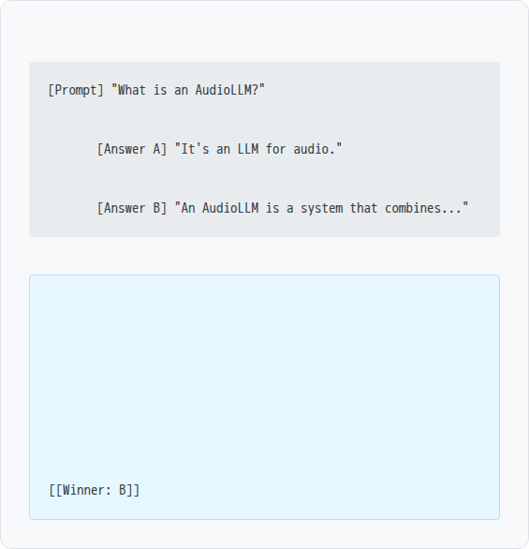
LLM-as-a-Judge: Pairwise Comparison
System Prompt
User Input:
You are a meticulous and objective evaluator. You will be given a user prompt and two AI-generated answers (A and B).
Your Task: Your goal is to determine which answer is better. First, provide a step-by-step critique of both answers. Second, compare them directly. Finally, provide your verdict in the format [[Winner: A]], [[Winner: B]], or [[Winner: Tie]].
LLM Judge Output:
Criteria: Judge based on helpfulness, accuracy, and clarity. Do not let the length or writing style of one answer overly influence your decision.
Critique: Answer A is technically correct but lacks any useful information. Answer B is comprehensive, defines the components, and lists example tasks. Comparison: Answer B is clearly superior as it is far more helpful and detailed. Answer A is a low-quality response.

Slide 34
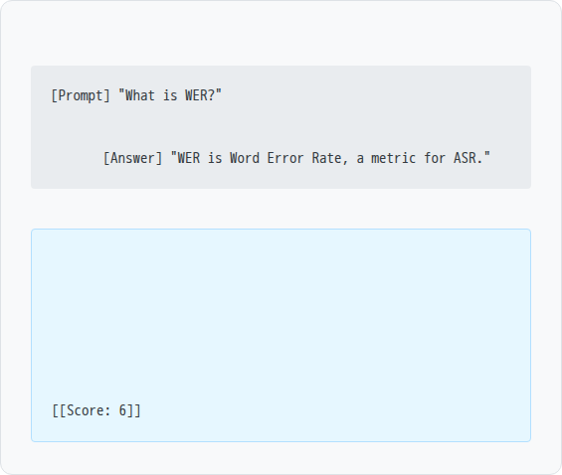
LLM-as-a-Judge: Single Answer Grading
System Prompt
User Input:
You are an evaluator. You will be given a user prompt and one AI answer. You must rate the answer on a scale of 1-10 based on the provided rubric.
Rubric:
LLM Judge Output:
• [1-3]: Incorrect, harmful, or irrelevant.
Reasoning: The answer is correct and provides the definition of the acronym, but it lacks any depth. It doesn't explain what the metric means or how it's used, stopping it from being a truly helpful answer. This fits the "Partially correct but incomplete" category.
• [4-6]: Partially correct but incomplete or poorly written.
• [7-8]: Helpful and accurate, but could be more detailed.
• [9-10]: Excellent, comprehensive, and well-written.
First, provide your reasoning for the score. Then, output the score in the exact format [[Score: X]].

Slide 35
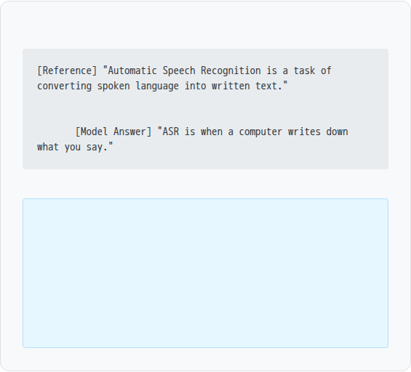
LLM-as-a-Judge: Reference-Guided Grading
System Prompt
User Input:
You are an evaluator. You will be given a 'Reference Answer' and a 'Model Answer' for a given prompt.
Your Task: Score the 'Model Answer' from 1-5 based *only* on its semantic equivalence to the 'Reference Answer'.
Rubric (Meaning):
LLM Judge Output:
• [1]: Contradicts the reference.
Reasoning: The model's answer uses simpler language ("writes down what you say") but it is a correct and complete paraphrase of the reference ("converting spoken language into written text"). It fully captures the semantic meaning.
• [3]: Captures some, but not all, of the reference's meaning.
• [5]: Captures all of the reference's meaning. Paraphrasing is acceptable.
First, provide your reasoning. Then, output the score in the format [[Score: X]].
[[Score: 5]]

Slide 36
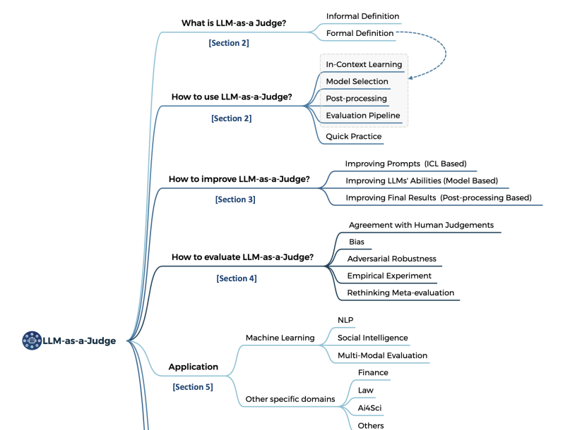
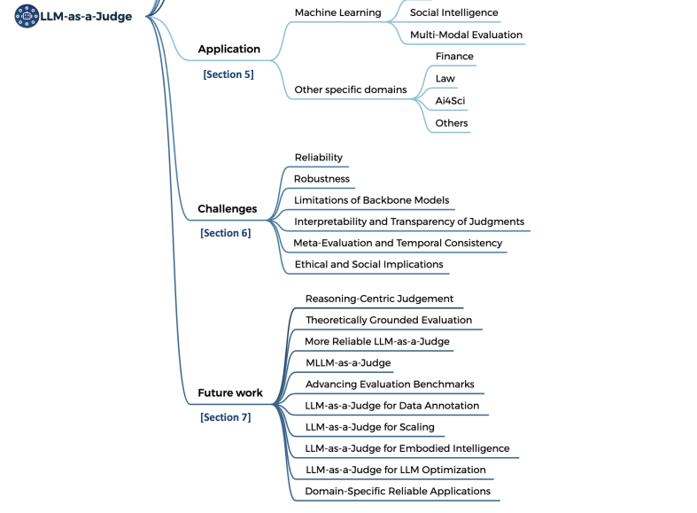
LLM-as-a-Judge
https://arxiv.org/pdf/2411.15594v6

Slide 37
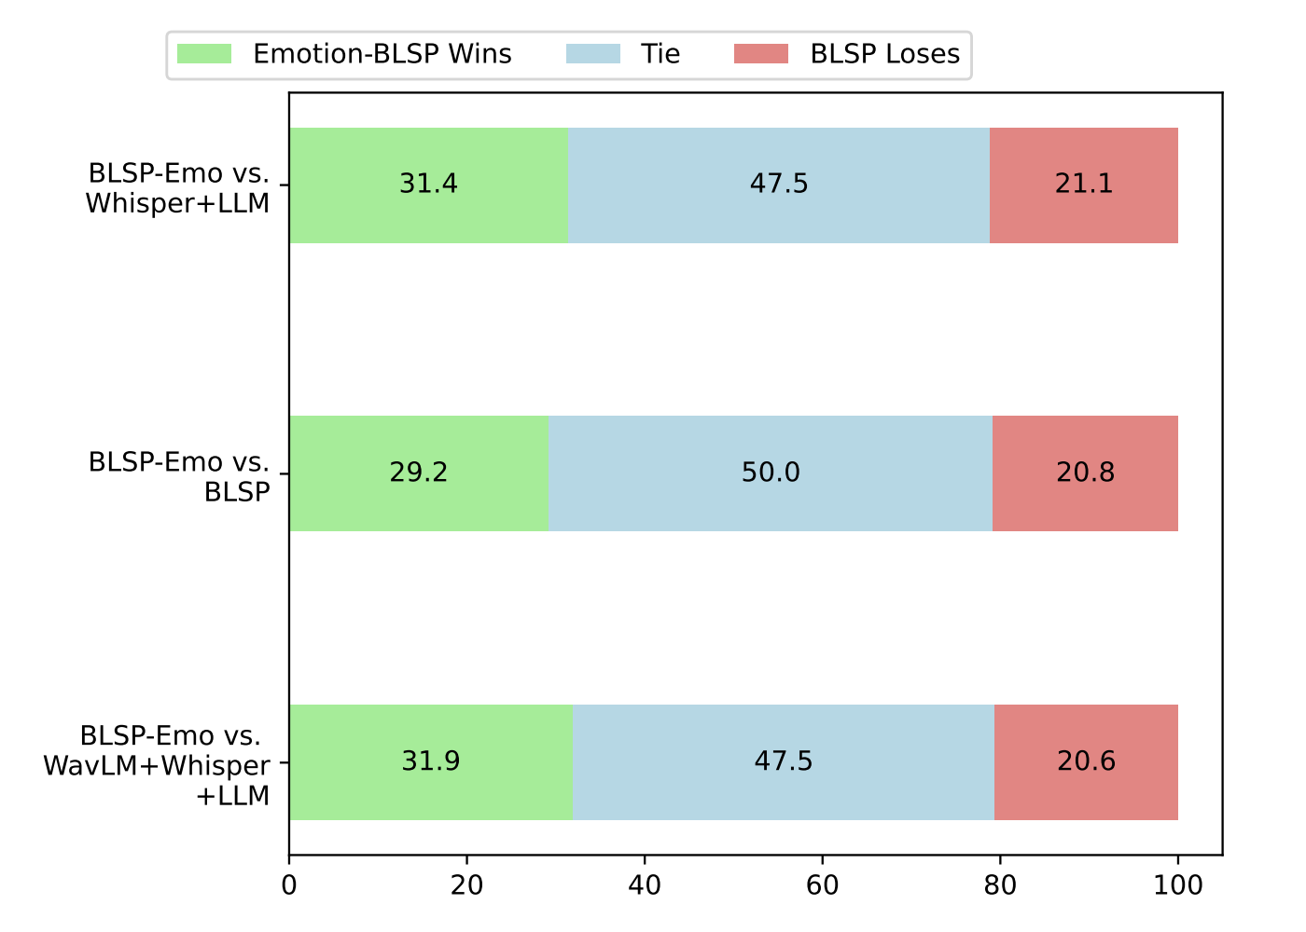
LLM-as-a-Judge: Response Empathicity Case
Synthetic Emotion-Aware Speech Instruction dataset
Generate plausible emotion label for text sample with LLM
Synthesize Instruction with Emotional TTS
Assess AudioLLM out with Empathy-targeted prompt
https://arxiv.org/pdf/2406.03872v1

Slide 38
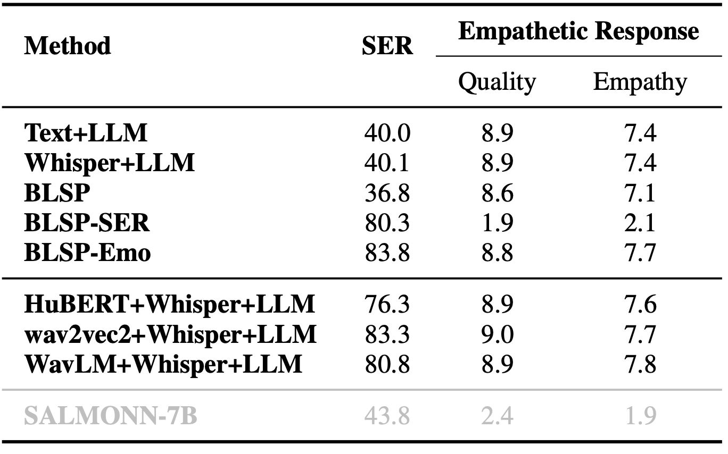
LLM-as-a-Judge: Response Empathicity Case
Synthetic Emotion-Aware Speech Instruction dataset
Generate plausible emotion label for text sample with LLM
Synthesize Instruction with Emotional TTS
Assess AudioLLM out with Empathy-targeted prompt
https://arxiv.org/pdf/2406.03872v1

Slide 39
Audio-Conditioned LLM: Architecture
Hidden Embeddings
1
2
3
4
5
6
LLM Decoder
Text embeddings
0
1
2
3
4
5
Text tokens
0
1
2
3
4
5

Slide 40
Audio-Conditioned LLM: Architecture
Hidden Embeddings
1
2
3
4
5
6
LLM Decoder
Text embeddings
0
1
2
3
4
5
Text tokens
0
1
2
3
4
5

Slide 41
Audio-Conditioned LLM: Architecture
CE-loss
Hidden Embeddings
1
2
3
4
5
6
LLM Decoder
Text embeddings
0
1
2
3
4
5
Text tokens
0
1
2
3
4
5

Slide 42

Audio-Conditioned LLM: Architecture
Sample
What does this record say?
There's a lecture on AudioLLM on the record.
<audio_file>
Hidden Embeddings
1
2
3
4
5
6
LLM Decoder
Text embeddings
0
1
2
3
4
5
Text tokens
0
1
2
3
4
5

Slide 43
Audio-Conditioned LLM: Architecture
Sample
What does this record say?
There's a lecture on AudioLLM on the record.
<audio_file>
Hidden Embeddings
1
2
3
4
5
6
LLM Decoder
Text embeddings
0
1
2
3
4
5
Text tokens
0
1
2
3
4
5

Slide 44
Audio-Conditioned LLM: Architecture
How to encode audio?
How to pass audio representations?
Discrete / Continuous
Semantic / Acoustic
(debatable)
Vocab Extension with discrete tokens
Continuous Audio Embeddings in Prompt
Continuous Audio Embeddings, Cross-Attention

Slide 45
Audio Encoding Classification
Semantic representations
Acoustic representations

Slide 46
Audio Encoding Classification
Semantic representations
Obtained from encoders, trained on semantic task - ASR / LM-based SSL
Good for semantic tasks
Support more aggressive downsampling
Acoustic representations
Obtained from encoders, trained on recounstruction task - autoencoding
Good for audio generation task
Usually require complicated logic & higher rate

Slide 47
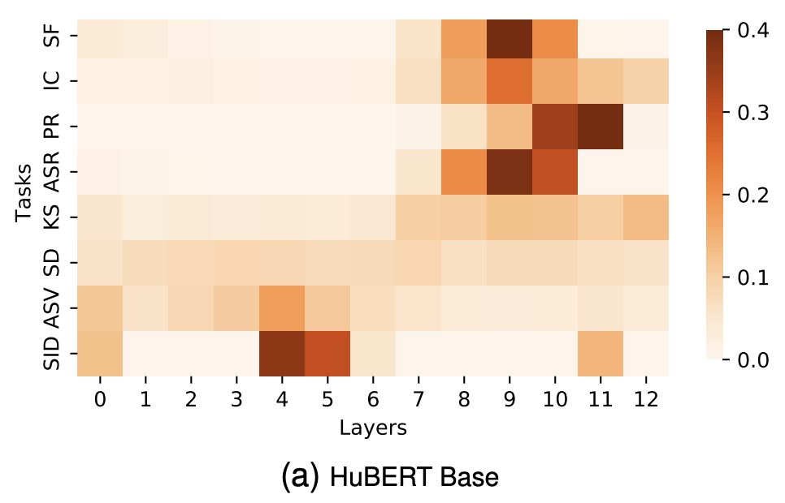
SUPERB benchmark
SUPERB: Speech processing Universal PERformance Benchmark
superbbenchmark.org
×
Layer n
wn
…
×
+
Downstream Head
Layer 2
w2
×
Layer 1
w1

Slide 48
Audio-Conditioned LLM: Architecture
Sample
What does this record say?
There's a lecture on AudioLLM on the record.
<audio_file>
3 Main Approaches
Audio Tokens
Continuous Audio Embeddings, Cross-Attention
Continuous Audio Embeddings in Prompt
All 3 requires some Audio Encoding module

Slide 49
Audio-Conditioned LLM: Architecture
Approach 1: Audio Tokens
Generation ability
Lossy
a0
a1
a2
1
1
2
2
3
3
4
4
5
5
6
6
Hidden Embeddings
LLM Decoder
a0
a1
a2
0
1
2
3
4
5
Text embeddings
a0
a1
a2
0
1
2
3
4
5
Text tokens

Slide 50
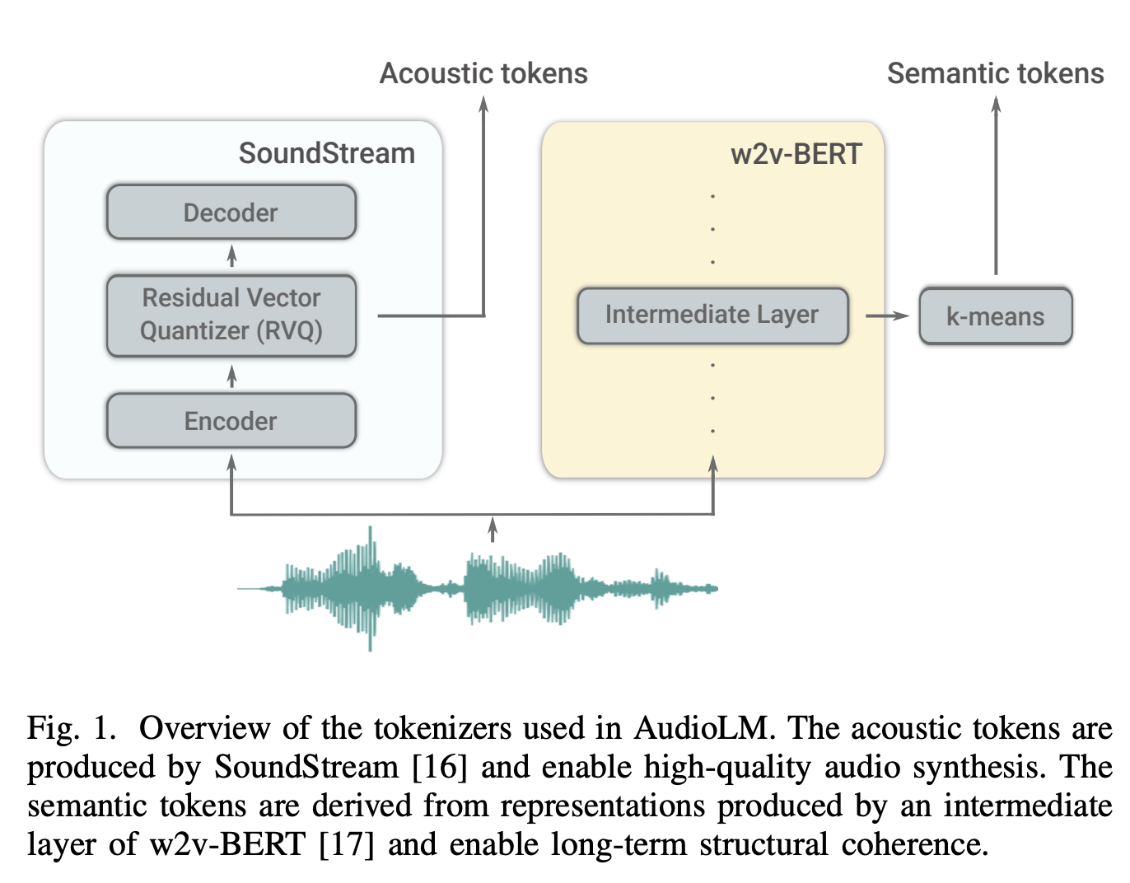
AudioLM
Semantic & Acoustic tokens
Speech / Music Continuation Task
300M Params, Trained from scratch
https://arxiv.org/pdf/2209.03143

Slide 51
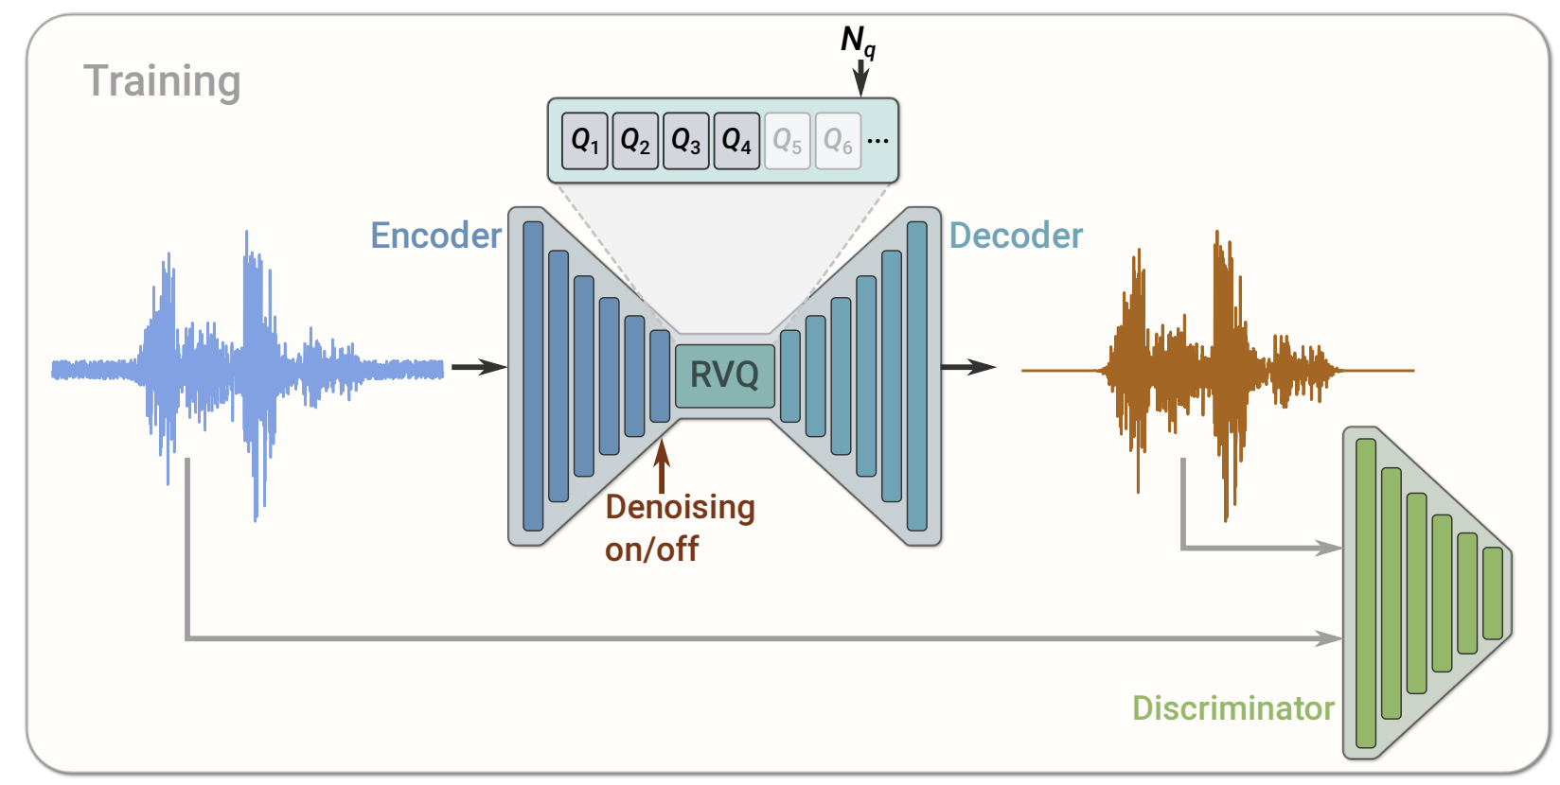
AudioLM
Semantic & Acoustic tokens
SoundStream codec
Speech / Music Continuation Task
300M Params, Trained from scratch
https://arxiv.org/abs/2107.03312

Slide 52
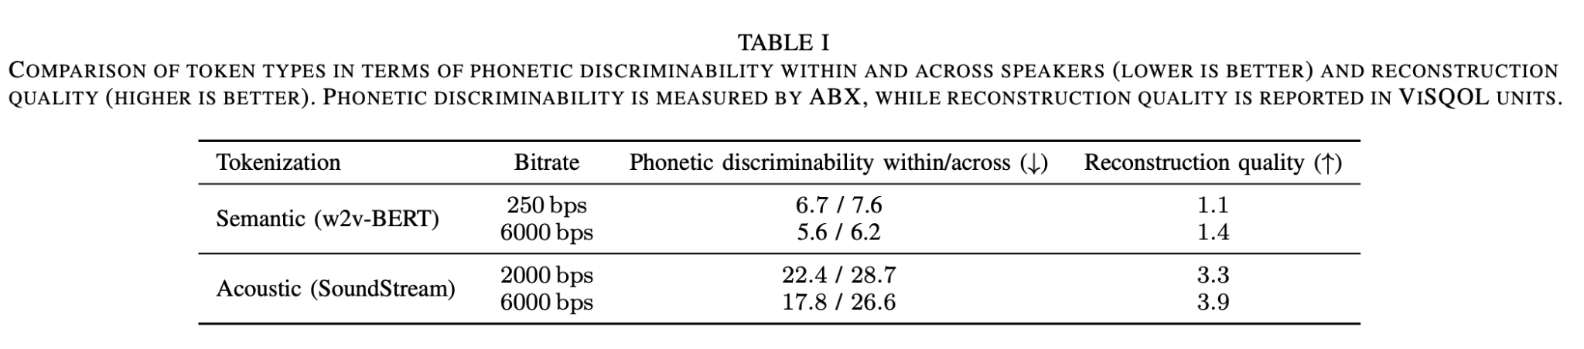
AudioLM
Semantic & Acoustic tokens
Speech / Music Continuation Task
300M Params, Trained from scratch
https://arxiv.org/pdf/2209.03143

Slide 53
Discrete vs Continuous tokens
Discrete tokens usually obtained from continuous embeddings
We can compare continuous and corresponding discrete form
https://arxiv.org/pdf/2411.08742v1

Slide 54
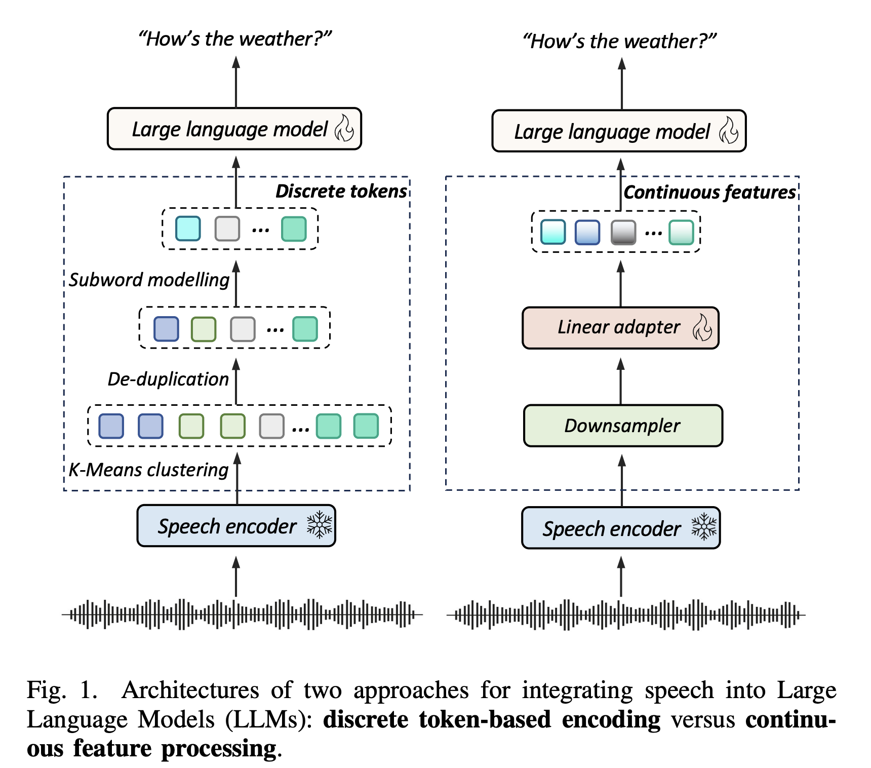
Discrete vs Continuous tokens
Discrete tokens usually obtained from continuous embeddings
We can compare continuous and corresponding discrete form
https://arxiv.org/pdf/2411.08742v1

Slide 55
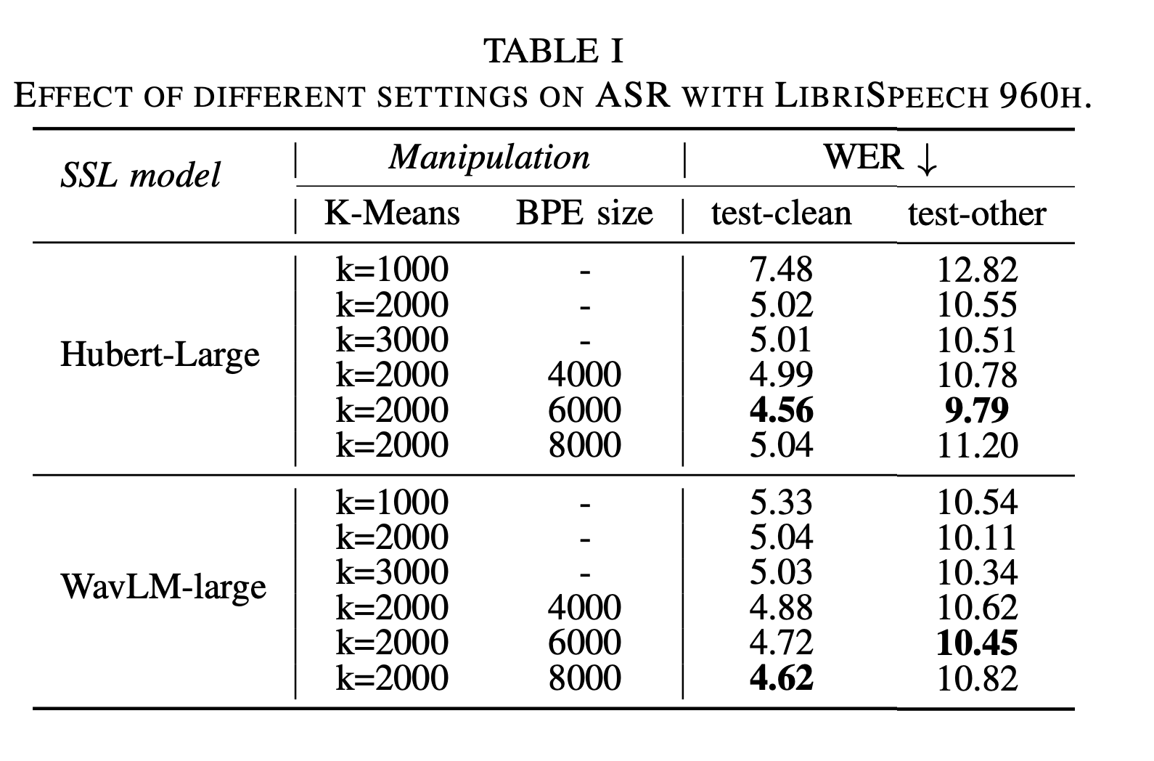
Discrete vs Continuous tokens
https://arxiv.org/pdf/2411.08742v1

Slide 56
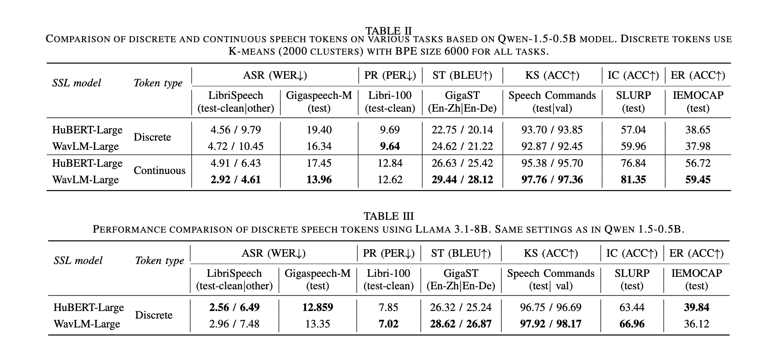
Discrete vs Continuous tokens
https://arxiv.org/pdf/2411.08742v1

Slide 57
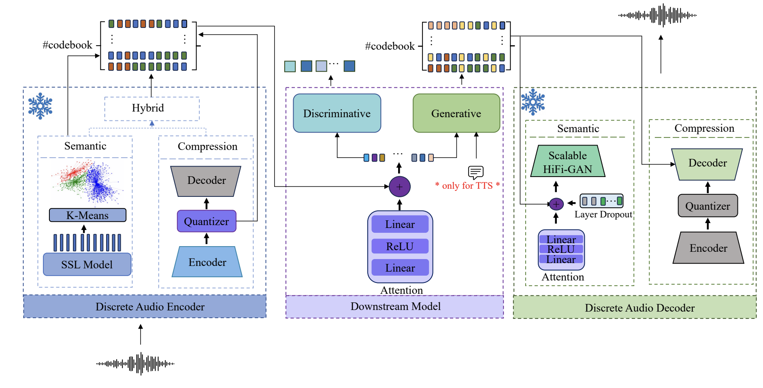
Discrete Audio and Speech Benchmark
https://arxiv.org/pdf/2406.14294

Slide 58
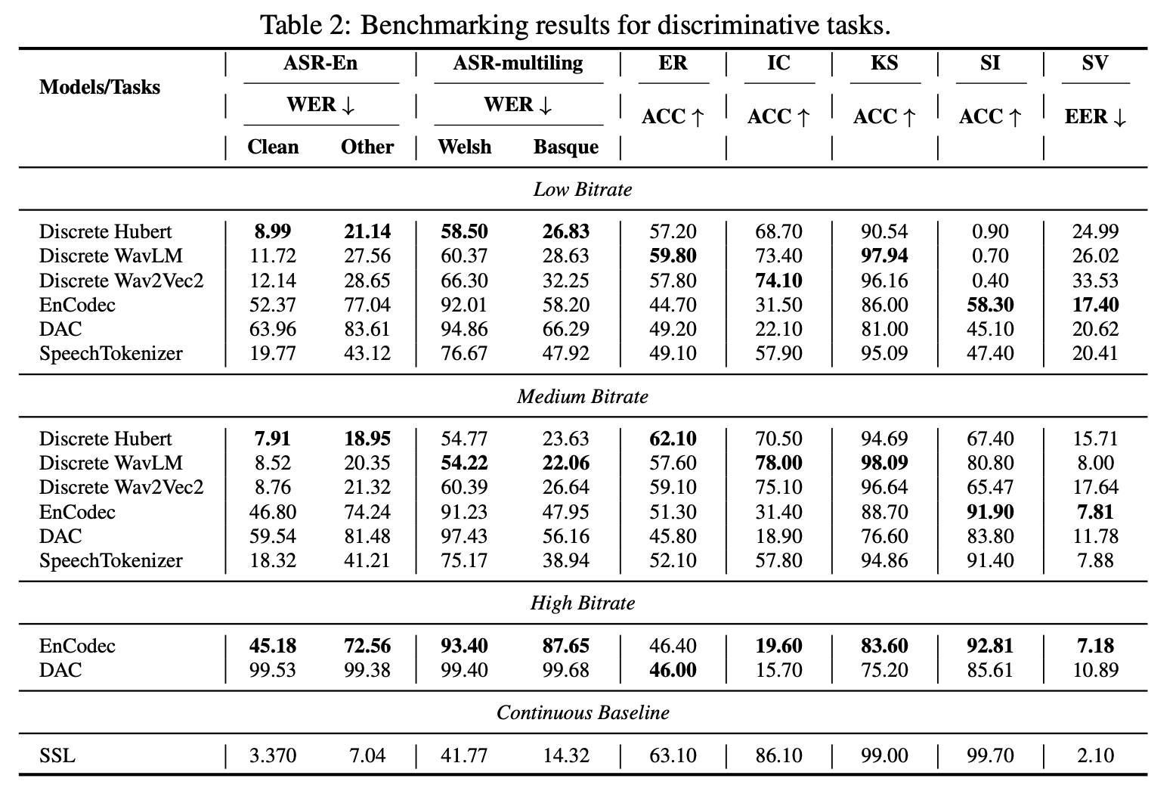
Discrete Audio and Speech Benchmark
https://arxiv.org/pdf/2406.14294

Slide 59
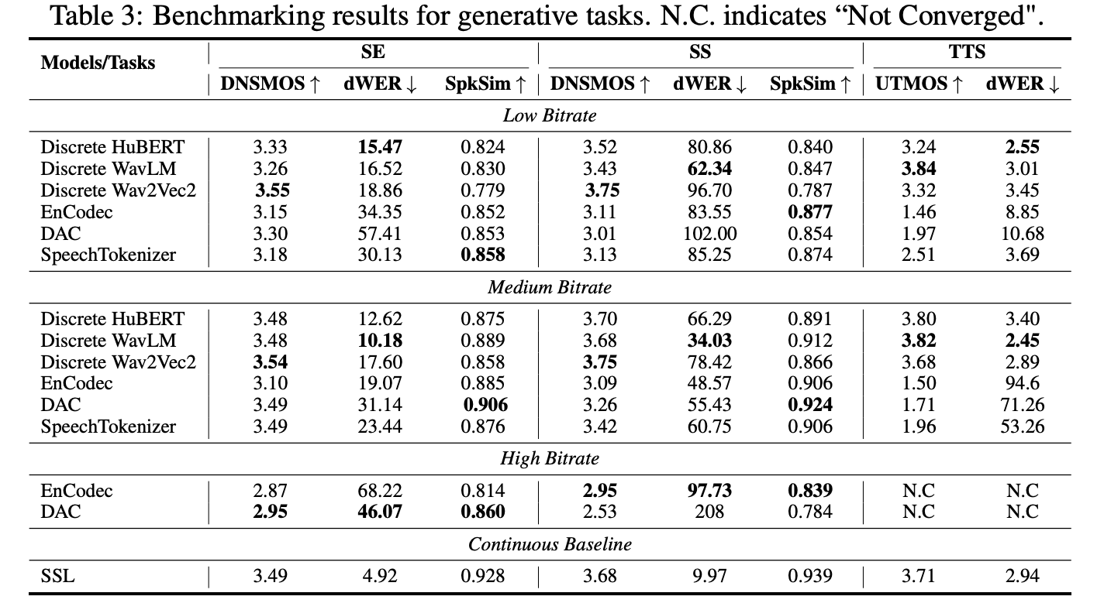
Discrete Audio and Speech Benchmark
https://arxiv.org/pdf/2406.14294

Slide 60
Audio-Conditioned LLM: Architecture
Approach 2:
Continuous Audio Embeddings, Cross-Attention
1
1
2
2
3
3
4
4
5
5
6
6
Hidden Embeddings
LLM Decoder
0
1
2
3
4
5
Text embeddings
0
1
2
3
4
5
Text tokens

Slide 61
Audio-Conditioned LLM: Architecture
Approach 2:
Continuous Audio Embeddings, Cross-Attention
1
1
2
2
3
3
4
4
5
5
6
6
Hidden Embeddings
LLM Decoder
Masked Cross Attention
a0
a1
a2
0
1
2
3
4
5
Text embeddings
0
1
2
3
4
5
Text tokens

Slide 62
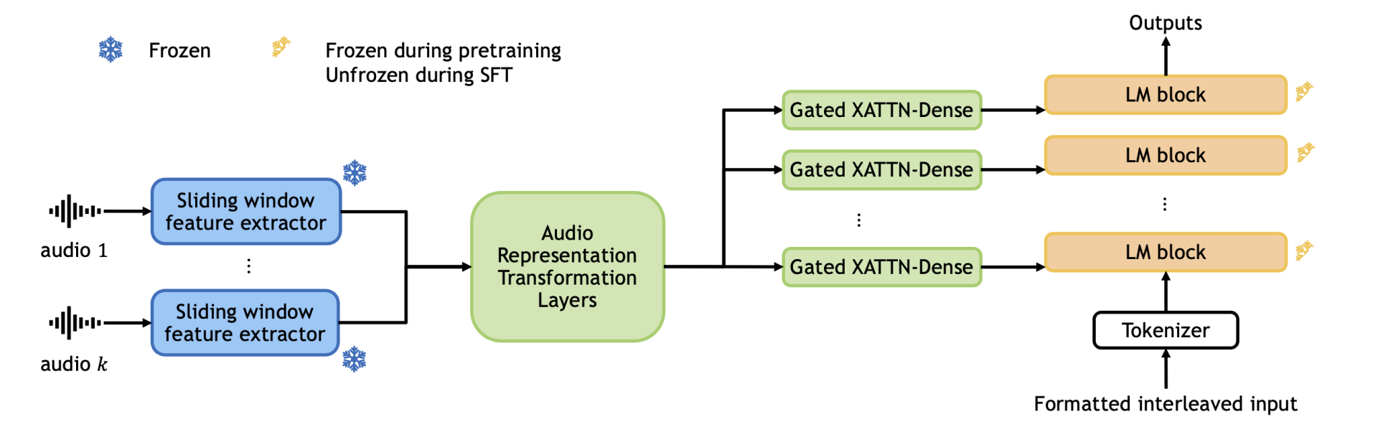
Audio-Conditioned LLM: Audio-FLamingo v1,2
https://arxiv.org/pdf/2503.03983

Slide 63
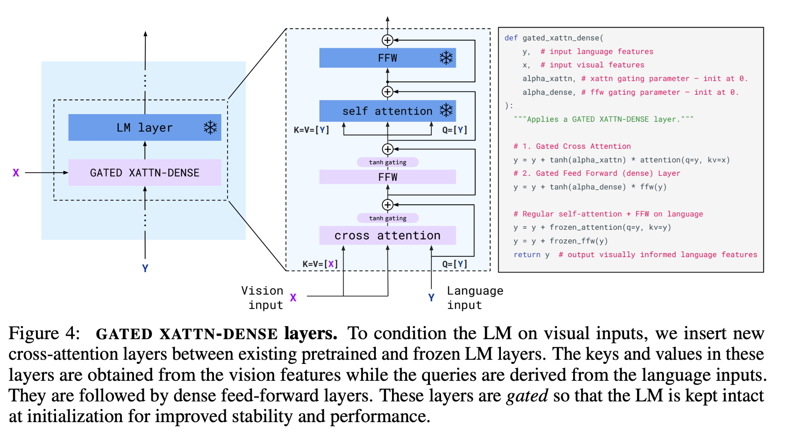
Audio-Conditioned LLM: Audio-FLamingo v1,2
https://arxiv.org/pdf/2204.14198

Slide 64
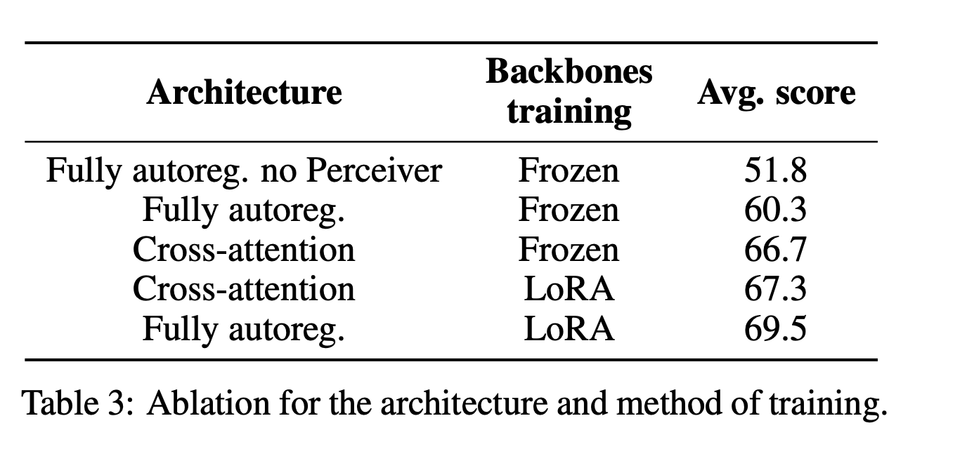
Audio-Conditioned LLM: Audio-FLamingo v1,2
https://arxiv.org/pdf/2405.02246

Slide 65

Audio-Conditioned LLM: Main Architecture
Approach 3:
Continuous Audio Embeddings in Prompt
1
1
2
2
3
3
4
4
5
5
6
6
Hidden Embeddings
LLM Decoder
a0
a1
a2
0
1
2
3
4
5
Text embeddings
Audio
0
1
2
3
4
5
Text tokens

Slide 66
Audio-Conditioned LLM: Main Architecture
Approach 3:
Continuous Audio Embeddings in Prompt
1
1
2
2
3
3
4
4
5
5
6
6
Hidden Embeddings
LLM Decoder
a0
a1
a2
0
1
2
3
4
5
Text embeddings
Audio Encoder
Audio
0
1
2
3
4
5
Text tokens

Slide 67
Audio-Conditioned LLM: Main Architecture
Approach 3:
Continuous Audio Embeddings in Prompt
1
1
2
2
3
3
4
4
5
5
6
6
Hidden Embeddings
LLM Decoder
a0
a1
a2
0
1
2
3
4
5
Text embeddings
Audio Encoder
Subsampler
Projector
Audio
0
1
2
3
4
5
Text tokens

Slide 68
Audio-Conditioned LLM: Main Architecture
Approach 3:
Continuous Audio Embeddings in Prompt
1
1
2
2
3
3
4
4
5
5
6
6
Hidden Embeddings
How to choose encoder?
How to choose projector?
How to choose subsampling rate?
LLM Decoder
a0
a1
a2
0
1
2
3
4
5
Text embeddings
Audio Encoder
Subsampler
Projector
Audio
0
1
2
3
4
5
Text tokens

Slide 69
Audio Encoding Classification
Semantic representations
Obtained from encoders, trained on semantic task - ASR / LM-based SSL
Good for semantic tasks
Support more aggressive downsampling
Acoustic representations
Obtained from encoders, trained on recounstruction task - autoencoding
Good for audio generation task
Usually require complicated logic & higher rate

Slide 70
Audio-Conditioned LLM: Main Architecture
WavLLM: Whisper (semantic) + WavLM (acoustic)

Slide 71
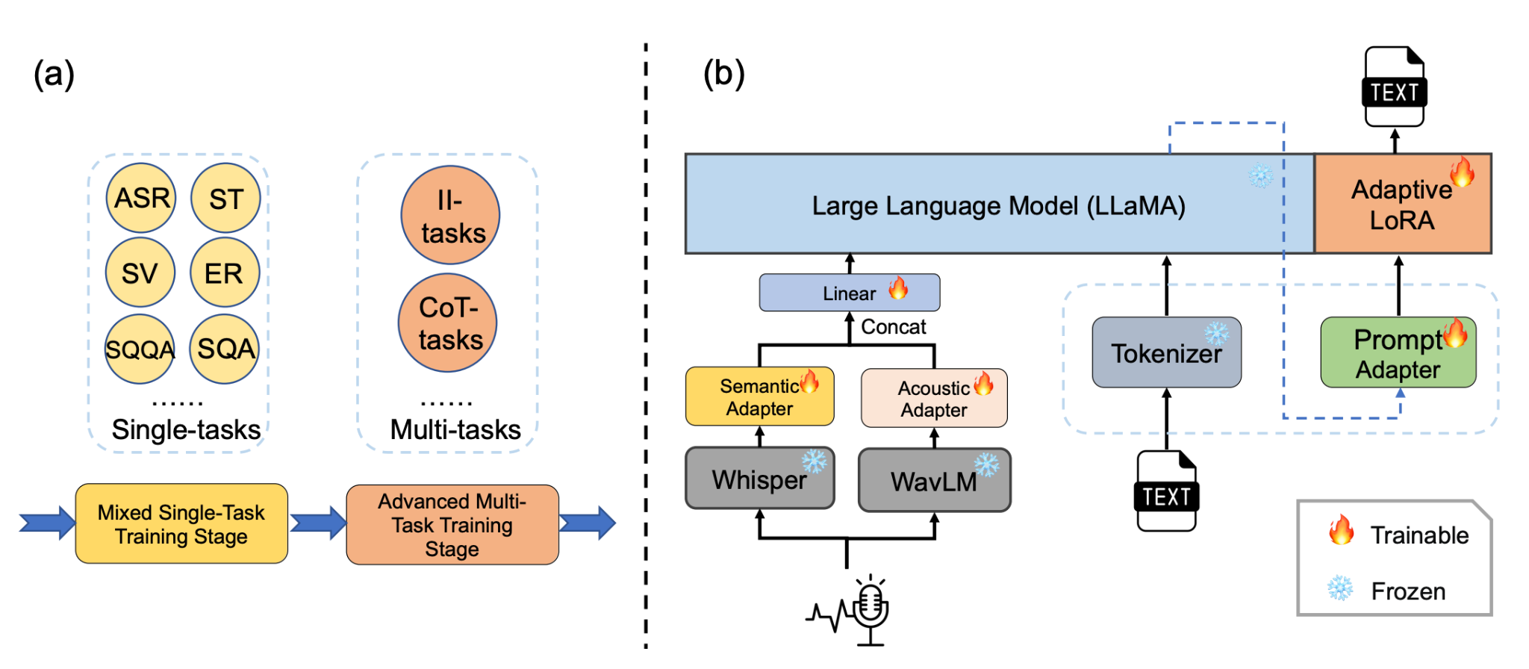
Audio-Conditioned LLM: Main Architecture
WavLLM: Whisper (semantic) + WavLM (acoustic)

Slide 72
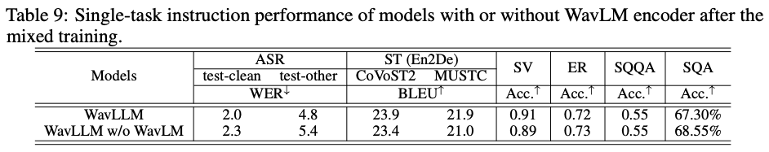
Audio-Conditioned LLM: Main Architecture
WavLLM: Whisper (semantic) + WavLM (acoustic)

Slide 73
Audio-Conditioned LLM: Main Architecture
WavLLM: Whisper (semantic) + WavLM (acoustic)
SALMONN: Whisper (semantic) + BEATs (acoustic)

Slide 74
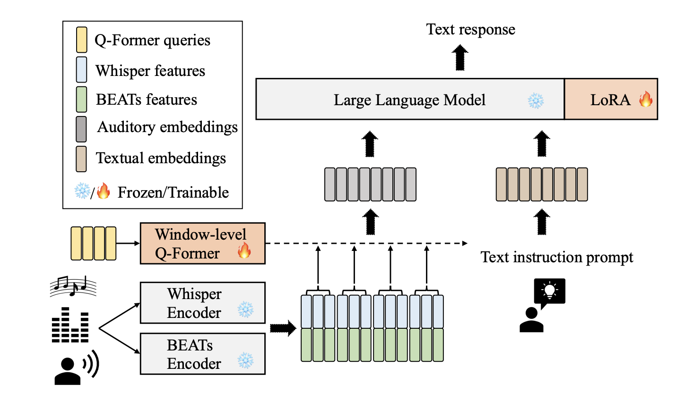
Audio-Conditioned LLM: Main Architecture
WavLLM: Whisper (semantic) + WavLM (acoustic)
SALMONN: Whisper (semantic) + BEATs (acoustic)

Slide 75
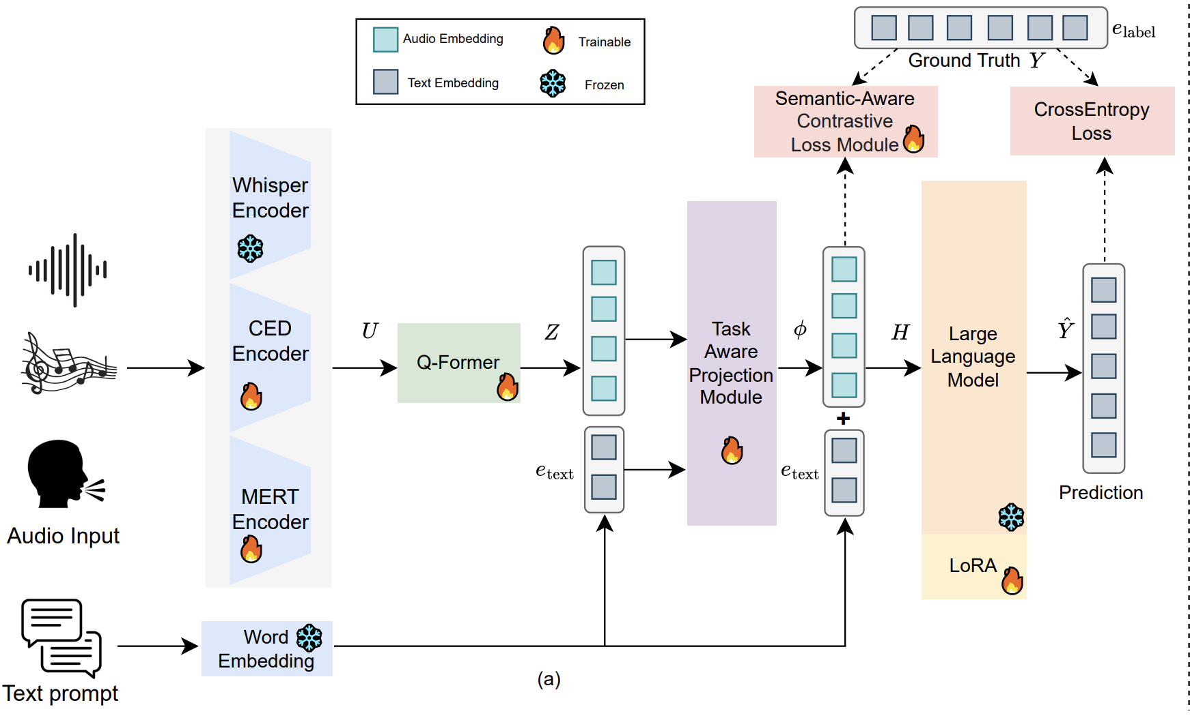
Audio-Conditioned LLM: Main Architecture
WavLLM: Whisper (semantic) + WavLM (acoustic)
SALMONN: Whisper (semantic) + BEATs (acoustic)
U-SAM: Whisper (semantic) + CED (acoustic) + MERT (music)

Slide 76
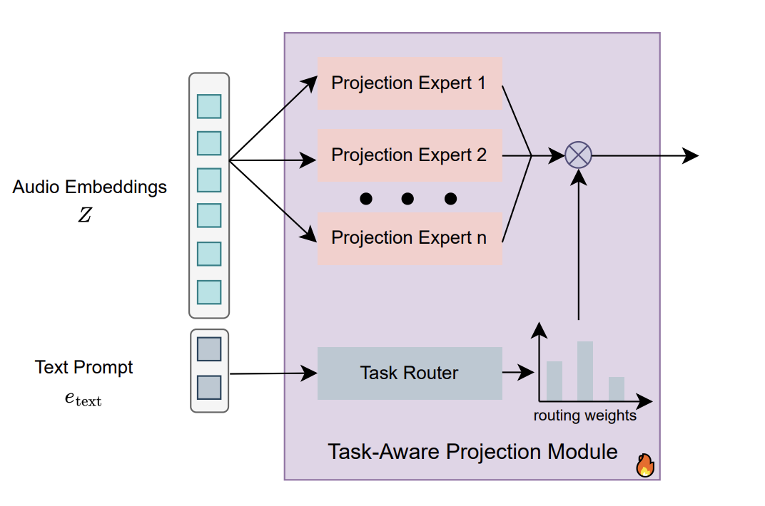
Audio-Conditioned LLM: Main Architecture
WavLLM: Whisper (semantic) + WavLM (acoustic)
SALMONN: Whisper (semantic) + BEATs (acoustic)
U-SAM: Whisper (semantic) + CED (acoustic) + MERT (music)

Slide 77
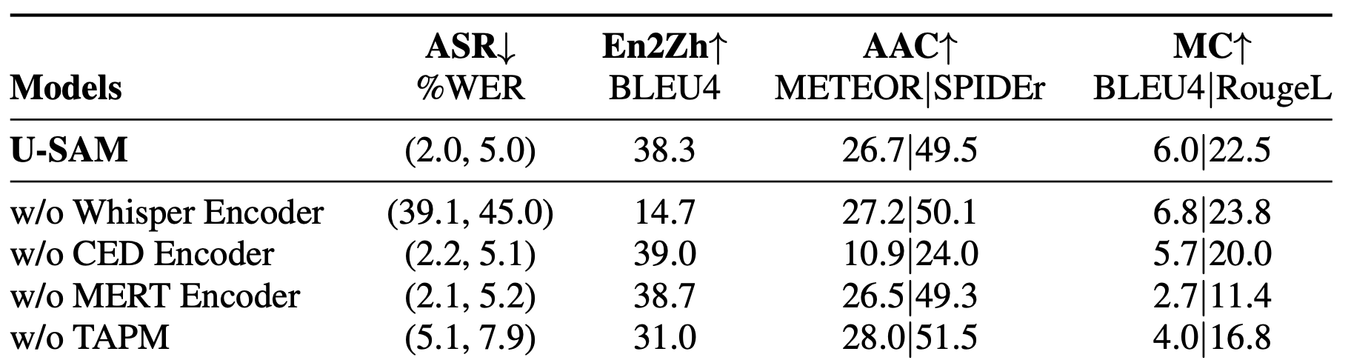
Audio-Conditioned LLM: Main Architecture
WavLLM: Whisper (semantic) + WavLM (acoustic)
SALMONN: Whisper (semantic) + BEATs (acoustic)
U-SAM: Whisper (semantic) + CED (acoustic) + MERT (music)

Slide 78
Audio-Conditioned LLM: Main Architecture
WavLLM: Whisper (semantic) + WavLM (acoustic)
SALMONN: Whisper (semantic) + BEATs (acoustic)
U-SAM: Whisper (semantic) + CED (acoustic) + MERT (music)
Audio-Flamingo v3: Comparison AF-Whisper vs. CLAP + Whisper

Slide 79
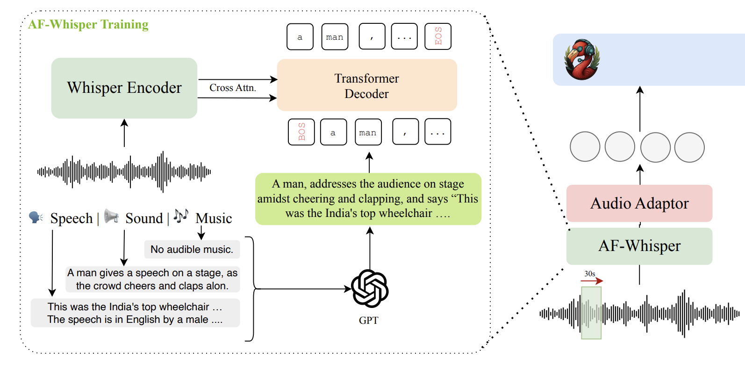
Audio-Conditioned LLM: Main Architecture
WavLLM: Whisper (semantic) + WavLM (acoustic)
SALMONN: Whisper (semantic) + BEATs (acoustic)
U-SAM: Whisper (semantic) + CED (acoustic) + MERT (music)
Audio-Flamingo v3: Comparison AF-Whisper vs. CLAP + Whisper

Slide 80
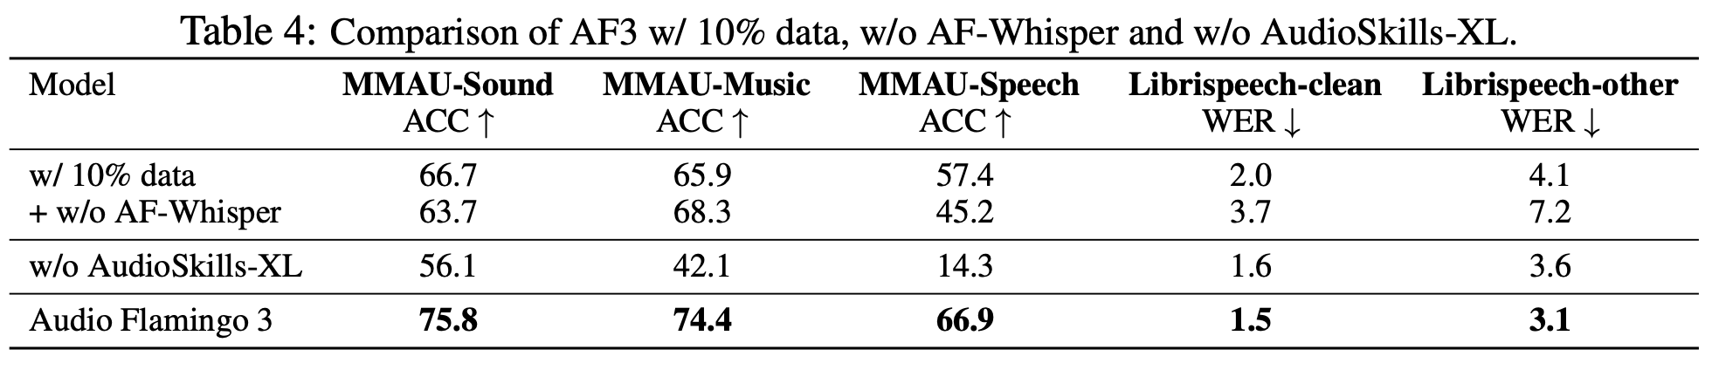
Audio-Conditioned LLM: Main Architecture
WavLLM: Whisper (semantic) + WavLM (acoustic)
SALMONN: Whisper (semantic) + BEATs (acoustic)
U-SAM: Whisper (semantic) + CED (acoustic) + MERT (music)
Audio-Flamingo v3: Comparison AF-Whisper vs. CLAP + Whisper

Slide 81
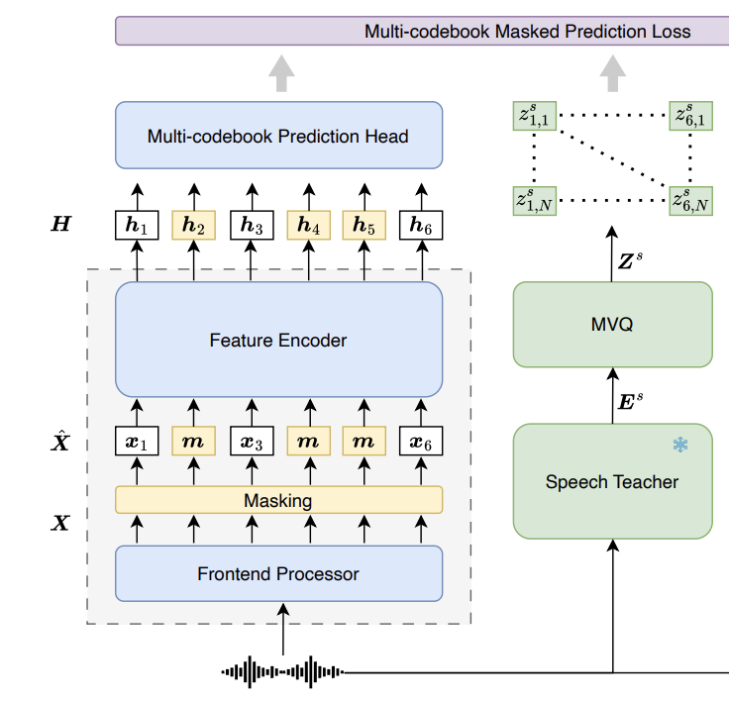
Offtop: Universal SSL-Encoder
K-means Clustering
https://arxiv.org/pdf/2510.25955

Slide 82
Offtop: Universal SSL-Encoder
https://arxiv.org/pdf/2510.25955

Slide 83
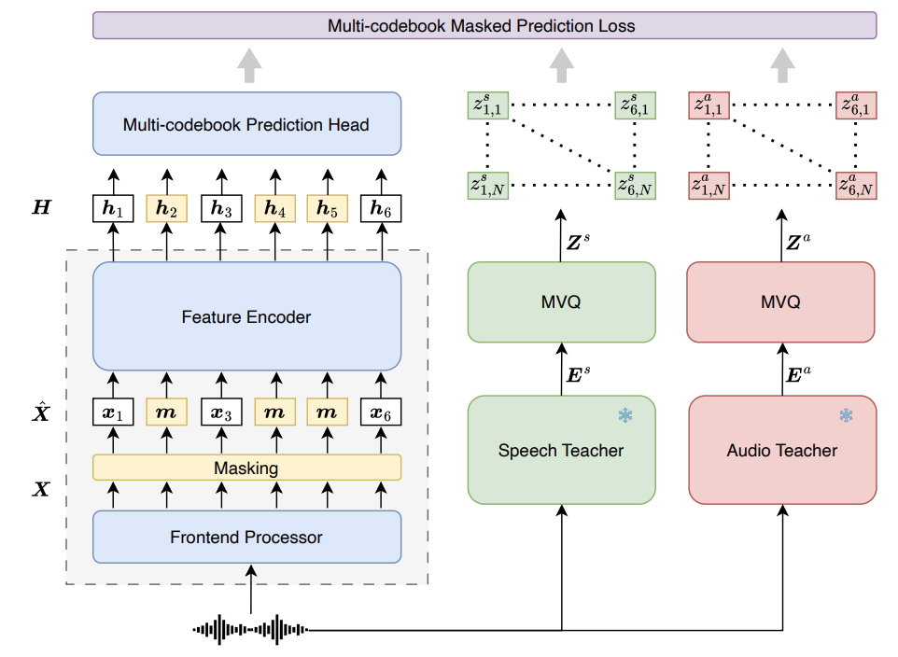
Offtop: Universal SSL-Encoder
https://arxiv.org/pdf/2510.25955

Slide 84
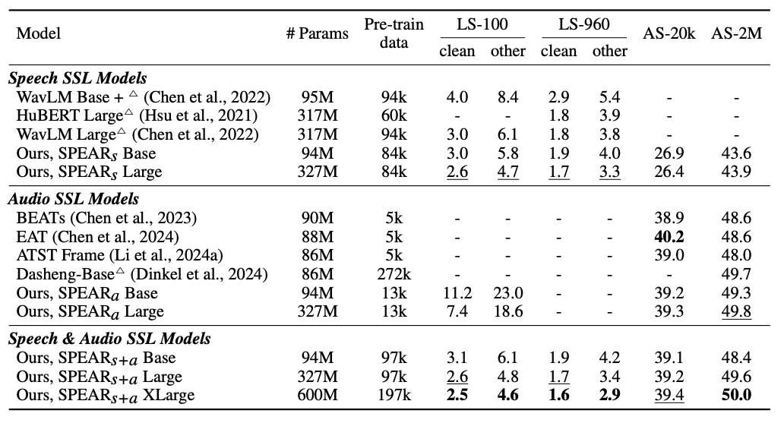
Offtop: Universal SSL-Encoder
https://arxiv.org/pdf/2510.25955

Slide 85
Encoders: Recap
Different encoders perform betters on different tasks
Depends mostly on model & data size AND pretraining task
AF-Whisper training stage made Whisper Encoder better choice for music / audio tasks than specific encoders
SSL-approaches that learn universal encoder through distillation

Slide 86
Audio-Conditoned LLM: Projectors & Subsampling
Projectors - we need to match LLM hidden dim with MLP
In some cases (frozen lm and encoder) - more complicated modules:
QFormer
Transofmer / Conformer
Task-Aware Projector (U-SAM)
Subsampling - we want code audio with minimum frame rate
Usually for Audio understanding use from 6Hz to 50Hz embedding
Frame rate of some popular encoders:
Whisper: 50Hz
WavLM: 50Hz
BEATs: 6.25Hz * 8 freq-patches
CLAP: 6.25Hz * 4 freq-patches

Slide 87
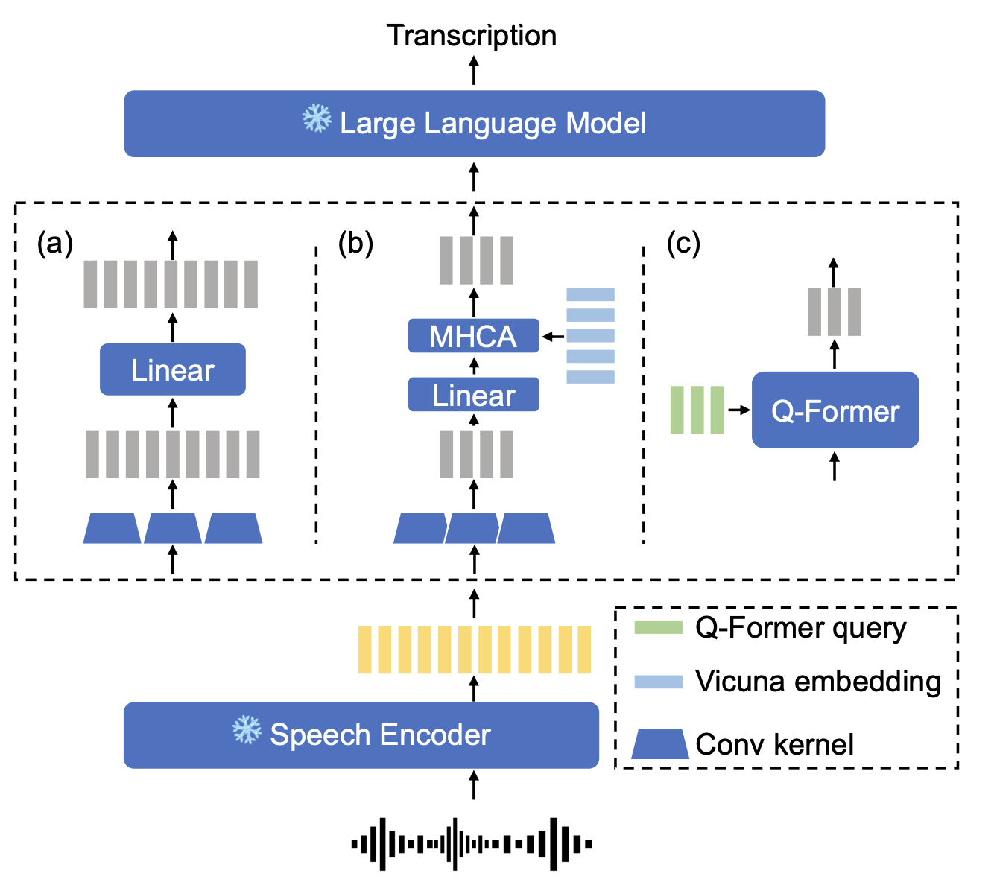
Audio-Conditoned LLM: Projectors
Comparing quality with:
Q-Former
Linear layer
Multi-Head Cross-Attention
https://arxiv.org/pdf/2309.13963

Slide 88
Audio-Conditoned LLM: Projectors
Comparing quality with:
Q-Former
Linear layer
Multi-Head Cross-Attention
https://arxiv.org/pdf/2309.13963

Slide 89
Audio-Conditoned LLM: Projectors
Comparing quality with:
Q-Former
Linear layer
Multi-Head Cross-Attention
https://arxiv.org/pdf/2309.13963

Slide 90
Audio-Conditoned LLM: Projectors
Comparing quality with:
Q-Former
Linear layer
Multi-Head Cross-Attention
https://arxiv.org/pdf/2309.13963

Slide 91





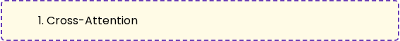


Audio-Conditoned LLM: Projectors
Audio Embeddings
Trainable
Comparing quality with:
Q-Former
Linear layer
Multi-Head Cross-Attention
Learnable Queries (32 tokens)
Any number of tokens, Keys & Values
Queries (Q) attend to Encoder Features (K, V)
Queries (Q, K, V) attend to each other
(Block is repeated N times)
Output Embeddings (32 tokens)
Projected and prepended to LLM prompt

Slide 92

Audio-Conditoned LLM: Projectors
Comparing quality with:
Q-Former
Linear layer
Multi-Head Cross-Attention

Slide 93
Audio-Conditoned LLM: Projectors
Comparing quality with:
Q-Former
Linear layer
Multi-Head Cross-Attention
Small difference
Mostly caused by frozen encoder & decoder

Slide 94

Audio-Conditoned LLM: Subsamplers
Reduce till the metrics start to fall

Slide 95

Audio-Conditoned LLM: Subsamplers
Reduce till the metrics start to fall
GigaChat-Audio Internal Ablations
GigaChat-Audio Internal Ablations

Slide 96

Audio-Conditoned LLM: Subsamplers
Reduce the metrics start to fall
https://arxiv.org/pdf/2507.13264v1

Slide 97
Projectors & Subsamplers Recap
Projectors:
Often Linear / MLP module is good enough choice
If LLM / encoder frozen - may be useful to use more complicated module
There is the growing number of papers researching dynamic compressing of audio embeddings, but there are no large-scale with such methods yet

Slide 98
Projectors & Subsamplers Recap
Subsamplers:
Reduce the metrics start to fall
There is the growing number of papers researching dynamic compressing of audio embeddings, but there are no large-scale with such methods yet
Notes:
End of architecture block

Slide 99
AudioLLM Training Stages & Data
Pre-training
LLM training (pretrain / sft / rl)
Encoder training (SSL / ASR / Specific Training)

Slide 100
AudioLLM Training Stages & Data
Pre-training
LLM training (pretrain / sft / rl)
Encoder training (SSL / ASR / Specific Training)
Modality Alignment
Usually - unfreeze adapter / encoder and train on simple tasks like ASR / AST / Classifications / Continutations / …

Slide 101
AudioLLM Training Stages & Data
Pre-training
LLM training (pretrain / sft / rl)
Encoder training (SSL / ASR / Specific Training)
Modality Alignment
Usually - unfreeze adapter / encoder and train on simple tasks like ASR / AST / Classifications / Continutations / …

Slide 102
AudioLLM Training Stages & Data
Pre-training
LLM training (pretrain / sft / rl)
Encoder training (SSL / ASR / Specific Training)
Modality Alignment
Usually - unfreeze adapter / encoder and train on simple tasks like ASR / AST / Classifications / Continutations / …
Supervised fine-tuning
Usually - finetuning on instructional datasets, unfreezing / adding Lora to LLM decoder

Slide 103
AudioLLM Training Stages & Data
Pre-training
LLM training (pretrain / sft / rl)
Encoder training (SSL / ASR / Specific Training)
Modality Alignment
Usually - unfreeze adapter / encoder and train on simple tasks like ASR / AST / Classifications / Continutations / …
Supervised fine-tuning
Usually - finetuning on instructional datasets, unfreezing / adding Lora to LLM decoder
Post training
RL
Context Extension
Reasoning

Slide 104
AudioLLM Training Stages & Data
Alignment data:
ASR data
AudioChatLLAMa creation

Slide 105

AudioLLM Training Stages & Data
Alignment data:
ASR data
AudioChatLLAMa creation
https://arxiv.org/pdf/2311.06753v2

Slide 106

AudioLLM Training Stages & Data
Alignment data:
ASR data
AudioChatLLAMa creation
Voxtral Interleaving-style creation
https://arxiv.org/pdf/2507.13264v1

Slide 107
AudioLLM Training Stages & Data
Alignment data:
ASR data
AudioChatLLAMa creation
Voxtral Interleaving-style creation
Transcription-based question & answer generation

Slide 108
AudioLLM Training Stages & Data
Alignment data:
ASR data
AudioChatLLAMa creation
Voxtral Interleaving-style creation
Transcription-based question & answer generation
Traditional ASR

Slide 109
AudioLLM Training Stages & Data
Alignment data:
ASR data
AudioChatLLAMa creation
Voxtral Interleaving-style creation
Transcription-based question & answer generation
Traditional ASR
Audio Captioning Data

Slide 110
AudioLLM Training Stages & Data
Alignment data:
ASR & AST data
AudioChatLLAMa creation
Voxtral Interleaving-style creation
Transcription-based question & answer generation
Traditional ASR
Audio Captioning Data
Any Open-Source data

Slide 111
AudioLLM Training Stages & Data
SFT (supervised fine-tuning) data:
ASR & AST data
Captioning data
Synthetic data (LLM & TTS using)
Audio Question Answering
Multiturn dialogues
Summarizations

Slide 112

Case Study Voxtral
Model: Whisper Encoder + Linear Adapter + Transformer Decoder
Subsampling: 4x to 12.5Hz
Decoder: 3B for Mini, 24B for Small
https://arxiv.org/pdf/2507.13264v1

Slide 113
Case Study Voxtral: Pretraining Stage
Freeze all, except adapter -> Unfreeze all?
Interleaving-style data
https://arxiv.org/pdf/2507.13264v1

Slide 114
Case Study Voxtral: SFT Stage Data
Audio context, Text Query
Synthetic QA created with Mistral Large on transcripts:
Factual questions
Needle-In-Haystack Retrieval
Reasoning
Multilingual
Synthetic summarization & translation
Audio-Only Input
Synthetic text sft data with TTS model
Extract questions from ASR data and generate text answer with Mistral Large
ASR with special token
https://arxiv.org/pdf/2507.13264v1

Slide 115
Case Study Voxtral: DPO
Online-DPO with text reward model, working on transcriptions + answers
https://arxiv.org/pdf/2507.13264v1

Slide 116
Case Study Voxtral: Evaluation
Speech Recognition
Speech Translation
https://arxiv.org/pdf/2507.13264v1

Slide 117
Case Study Voxtral: Evaluation
Speech Recognition
Speech Translation
Custom sets:
Filtering & Synthesis:
GSM8K
TriviaQA
MMLU
https://arxiv.org/pdf/2507.13264v1

Slide 118
Case Study Voxtral: Evaluation
Speech Recognition
Speech Translation
Custom sets:
Filtering & Synthesis
LLM-Judge Speech Understanding Benchmark:
https://arxiv.org/pdf/2507.13264v1

Slide 119
Case Study Voxtral: Evaluation
Speech Recognition
Speech Translation
Custom sets:
Filtering & Synthesis
LLM-Judge Speech Understanding Benchmark:
Binary helpfulness score: correct / incorrect
Grade Score: from 0 to 5
https://arxiv.org/pdf/2507.13264v1

Slide 120
Case Study Voxtral: Evaluation
Speech Recognition
Speech Translation
Custom sets:
Filtering & Synthesis
LLM-Judge Speech Understanding Benchmark:
Binary helpfulness score: correct / incorrect
Grade Score: from 0 to 5
Text Benches
https://arxiv.org/pdf/2507.13264v1

Slide 121

Case Study Voxtral: Speech Recognition Metrics
https://arxiv.org/pdf/2507.13264v1

Slide 122

Case Study Voxtral: Speech Translation Metrics
https://arxiv.org/pdf/2507.13264v1

Slide 123

Case Study Voxtral: Speech Understanding Metrics
https://arxiv.org/pdf/2507.13264v1

Slide 124

Case Study Voxtral: Speech Understanding Metrics
https://arxiv.org/pdf/2507.13264v1

Slide 125

Case Study Voxtral: Pretrain Taks Ablation
https://arxiv.org/pdf/2507.13264v1

Slide 126

Case Study Voxtral: DPO effect
https://arxiv.org/pdf/2507.13264v1

Slide 127
Recap
Why LLM
Why AudioLLM
What is Audio LLM
Types of AudioLLM
Audio-conditioned LLM tasks
Audio Input: encoders & speech tokens
Integration Audio embeddings into LLM
Training stages and data
Case Study

Slide 128

Спасибо за внимание!
@Alexandr_Maximenko

